Slide 1
AI LAB ASSIGNMENT WEEK-10 ASSIGNMENT(8)
By-AI_GROUP: 202051084 - Hemant Jat
202051123 - Nagpure Atharva
202051045 - Gagan Chandra
202051049 - Bhukya Vivek

Slide 2
Basics of data structure needed for state-space search tasks and use of random numbers required for MDP and RL Title: Matchbox Educable Naughts and Crosses Engine Problem Statement: Read the reference on MENACE by Michie and check for its implementations. Pick the one that you like the most and go through the code carefully. Highlight the parts that you feel are crucial. If possible, try to code the MENACE in any programming language of your liking

Slide 3
LEARINING OBJECTIVE:
What is Matchbox Educable Noughts and Crosses Engine
State-Space search
RL(Reinforcement Learning):
MDP(Markov Decision Process):
MENACE Code

Slide 4
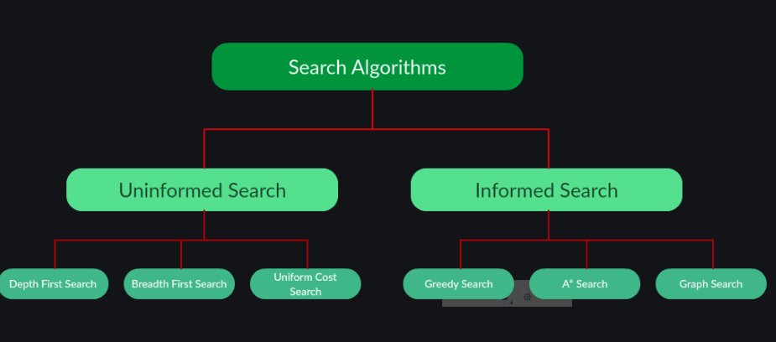
Basics of data structure:

Slide 5
Matchbox Educable Noughts and Crosses Engine
The Matchbox Educable Noughts and Crosses Engine (sometimes called the Machine Educable Noughts and Crosses Engine or MENACE) was a mechanical computer made from 304 matchboxes designed and built by artificial intelligence researcher “Donald Michie” in 1961.

Slide 6
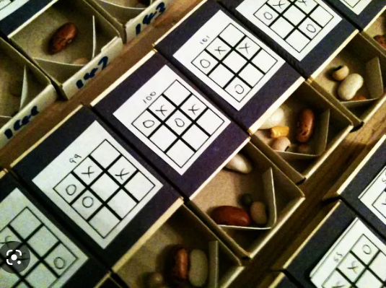
MENACE is a made of 304 match boxes which contains coloured beads.
Each match box in 304 match boxes printed different game state.

Slide 7

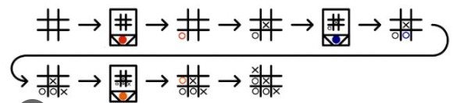
The front of each matchbox has a game of noughts and crosses printed on it. Each coloured bead inside the matchbox represents the next move MENACE could make.
To find out what move MENACE wants to make locate the matchbox which matches the current state of your game. Then shake the box and take out a bead at random. MENACE plays in the position corresponding to the coloured bead came out.

Slide 8
Learning: At the end of the game, it is time for MENACE to learn. Based on the outcome of the game, the following actions are performed:-
Add 3 beads of each colour to the boxes.
Draw
Add 1 bead of each colour to the boxes.
MENACE is beaten
Remove the selected beads from the boxes.
MENACE wins

Slide 9
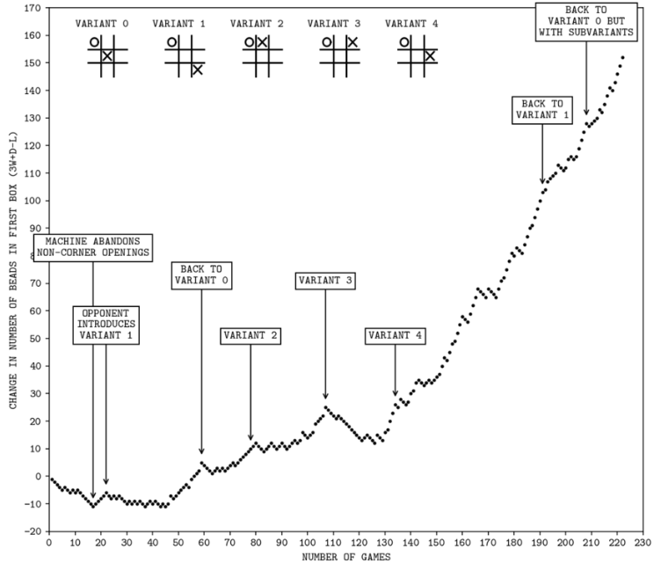
In this way, MENACE is encouraged to repeat moves that leads to winning and draws, and not repeat mistakes that leads to losing. Over the course of multiple games, MENACE learns to be a better noughts and crosses player.
We will be playing hundreds of games of noughts and crosses; check back to see the statistics of how good MENACE is getting. Is MENACE already better at noughts and crosses than you?
The progress of MENACE'S maiden tournament against a human opponent

Slide 10
State space representation of problem
All the states the system can be in are represented as nodes of a graph.
An action that can change the system from one state to another (e.g. a move in a game) is represented by a link from one node to another.
Links may be unidirectional (e.g. Xs and Os, can't go back) or bi-directional (e.g. geographic move).
Search for a solution.
A solution might be:
Any path from start state to goal state.
The best (e.g. lowest cost) path from start state to goal state
It may be possible to reach the same state through many different paths (obviously true in Xs and Os).
There may be loops in the graph (can go round in circle). No loops in Xs and Os.

Slide 11
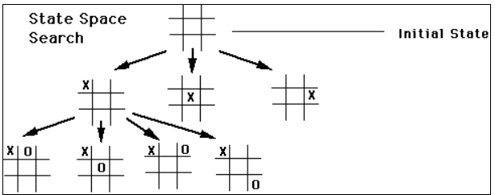
A state is a time snapshot representing some aspect of the problem
In artificial intelligence, this process known as state space search is used
Example: Representing Xs and Os as the state space problem.

Slide 12
RL(Reinforcement Learning):
Reinforcement Learning (RL) is the science of decision making. It is about learning the optimal behavior in an environment to obtain maximum reward
Example: The problem is as follows: We have an agent and a reward, with many hurdles in between. The agent is supposed to find the best possible path to reach the reward. In our case we can say that the agent is us and the reward is to win the game.

Slide 13
The reinforcement learning process can be broken down into four main components:
Agent: The decision maker that interacts with the environment and takes actions.
Environment: The external system with which the agent interacts, and which provides the agent with information about its actions and the resulting states.
Actions: The actions that the agent can take in the environment. These actions may have different effects depending on the state of the environment.
Rewards: The feedback signal that the agent receives from the environment in response to its actions. The reward signal is used to guide the agent towards better decision making.

Slide 14
The reinforcement learning process typically involves the agent selecting an action based on the current state of the environment, receiving a reward signal from the environment in response to its action, and using this reward signal to update its policy for making future decisions. The agent's policy is updated using an iterative process known as the reinforcement learning algorithm, which seeks to optimize the agent's actions over time to maximize the expected cumulative reward.
Reinforcement learning has been successfully applied in a variety of domains, including robotics, game playing, and recommendation systems. It is a powerful approach for training agents to make complex decisions in complex environments.

Slide 15
MDP(Markov Decision Process):
Its a stochastic decision-making process that uses a mathematical framework to model the decision-making of a dynamic system. It is used in scenarios where the results are either random or controlled by a decision maker, which makes sequential decisions over time
The key elements of an MDP are:
States: The set of possible situations or states that the decision maker can be in.
Actions: The set of possible actions that the decision maker can take in each state.
Transition probabilities: The probabilities of moving from one state to another when a particular action is taken. These probabilities are often represented by a transition function that takes the current state and action as inputs and returns the probabilities of the next state.

Slide 16
Rewards: The rewards or costs associated with each state-action pair. These rewards are typically represented by a reward function that takes the current state and action as inputs and returns the associated reward or cost.
Discount factor: A parameter that determines the importance of immediate rewards versus future rewards. It is used to discount future rewards to account for the time value of money or the uncertainty of future outcomes.
By defining these elements, an MDP can be used to find an optimal policy, which is a mapping from states to actions that maximizes the expected sum of rewards over time. Solving an MDP involves finding the value function or the Q-function, which gives the expected sum of rewards starting from a given state or state-action pair, respectively.

Slide 17
Reference:
https://www.mscroggs.co.uk/blog/19
http://people.csail.mit.edu/brooks/idocs/matchbox.pdf
https://we-make-money-not-art.com/menace-2-an-artificial-intelligence-made-of-wooden-drawers-and-coloured-beads/
https://www.mscroggs.co.uk/menace/
https://chalkdustmagazine.com/features/menace-machine-educable-noughts-crosses-engine/

Slide 18
Thank you

